Slide 1


Notes:
#

Slide 2



BEAM Battery Efficiency and AI Motor Optimization Team: Perfect Cube
College: Pranveer Singh Institute of Technology, Kanpur Date: 17/11/2024

Slide 3
Problem Overview
Electric vehicles (EVs) are at the forefront of sustainable transportation. EVs are revolutionizing the transportation sector, offering a sustainable alternative to conventional fossil-fuel-powered vehicles. However, EV adoption is hindered by significant challenges related to battery efficiency, motor performance, and user experience. Limited driving range, accelerated battery degradation, and inefficient energy management contribute to "range anxiety," making EVs less appealing to consumers. Moreover, achieving a balance between high motor performance and energy conservation remains a persistent challenge, especially in varying driving conditions such as steep terrains or urban traffic. The inability to make real-time decisions based on dynamic driving scenarios further exacerbates these issues, leading to suboptimal energy usage and reduced vehicle lifespan. Most systems fail to provide actionable insights or proactive alerts for predictive maintenance and energy optimization. As a result, users are often unaware of how to maximize their EV's potential, leading to inefficiencies and increased operational costs. Addressing these critical issues is essential to enhance EV performance, extend battery life, and improve overall user satisfaction, ultimately accelerating the transition to a more sustainable transportation future. These challenges include:
Battery Efficiency: Limited driving range due to inefficient battery usage.
Motor Performance: Balancing high-performance motor output with energy conservation.
Real-Time Decision Making: Current systems lack the ability to process sensor data in real-time.
User Experience: Increased costs for users from frequent battery replacements.

Slide 4
Proposed Solution
BEAM (Battery Efficient and AI Motor) integrates advanced AI technologies to address the dual challenges of battery efficiency and motor performance in electric vehicles (EVs). At its core, the Side Winder Snake Algorithm optimizes battery usage by dynamically adjusting power output to driving conditions, ensuring minimal energy consumption while extending battery life. Complementing this, Proximal Policy Optimization (PPO) leverages reinforcement learning to balance motor performance and energy conservation in real-time, providing a smooth driving experience across diverse terrains. Together, these algorithms ensure that EVs achieve both maximum range and optimal performance.
A fine-tuned Large Language Model (LLM) monitors and analyzes real-time sensor data, offering predictive insights for energy optimization and anomaly detection. Through advanced data analysis, BEAM identifies usage patterns, supports predictive maintenance, and generates actionable feedback via a user-friendly interface. Additionally, Reinforcement Learning enables continuous improvement of energy and performance policies, adapting to changing conditions over time. To enhance user engagement, BEAM employs TTS (Text-to-Speech) Alerts and Notifications, delivering real-time voice updates on battery status, performance tips, and maintenance reminders, ensuring drivers remain informed and focused.
This comprehensive solution not only enhances battery efficiency by up to 30% and extends battery life but also improves overall user experience, setting a new benchmark for sustainable and intelligent EV systems.

Slide 5
Implementing Side Winder and Proximal Policy Optimization:
Side Winder Snake Algorithm: The Side Winder Snake Algorithm is a metaheuristic optimization technique designed to maximize battery efficiency in electric vehicles. Inspired by the wave-like movements of a snake, the algorithm dynamically adjusts power output by analyzing real-time driving conditions such as terrain, speed, and load. It ensures optimal energy distribution across vehicle components, reducing wastage and enhancing battery life. By prioritizing energy-efficient paths and adapting to changing scenarios, this algorithm significantly extends the vehicle’s range while maintaining seamless performance, especially in urban stop-and-go traffic or uneven terrains.
Proximal Policy Optimization (PPO): Proximal Policy Optimization (PPO) is a reinforcement learning algorithm that optimizes motor performance while maintaining energy efficiency. It learns from key parameters such as battery percentage, temperature, and speed to make intelligent adjustments in real-time. By analyzing these variables, PPO continuously refines its policies, ensuring optimal energy utilization and motor behavior under varying conditions. This allows the system to balance energy conservation and performance, adapting seamlessly to factors like high-speed driving or temperature-induced battery fluctuations. PPO’s dynamic learning capability ensures a smarter, more efficient, and reliable electric vehicle operation.

Slide 6
Positive Impacts of BEAM:
Enhanced Battery Efficiency: BEAM optimizes battery usage, extending the driving range of electric vehicles by up to 30%, reducing the need for frequent recharging and addressing "range anxiety" for drivers.
Prolonged Battery Lifespan: By reducing wear and tear through intelligent energy distribution, BEAM increases battery longevity by up to 40%, lowering long-term replacement costs for EV owners.
Improved Performance: Real-time optimization of motor dynamics ensures smoother acceleration, better handling, and consistent performance, even under challenging conditions like steep inclines or variable terrains.
Environmental Sustainability: BEAM reduces energy consumption and CO2 emissions, promoting a cleaner environment and contributing to global sustainability goals.
Predictive Maintenance: Advanced monitoring systems proactively detect potential issues, including battery health degradation, minimizing vehicle downtime and repair costs while enhancing reliability.
Enhanced User Experience: Features like TTS alerts, actionable feedback, and intuitive dashboards provide drivers with real-time insights and guidance, including the nearest charging point distance, ensuring safety and convenience.
Cost Savings: By improving energy efficiency and battery lifespan, BEAM reduces operational and maintenance expenses, making EVs more economically viable for users.
Adaptability and Scalability: The system learns and evolves through reinforcement learning, making it adaptable to future EV models, driving patterns, and emerging energy-saving technologies.
An LLM can enhance a battery efficiency system by integrating real-time energy data with location-based services, predicting the nearest charging port based on current energy levels, and providing intelligent user interactions such as battery status updates, route suggestions, and charging port availability, all while optimizing the user experience through conversational interfaces.

Slide 7
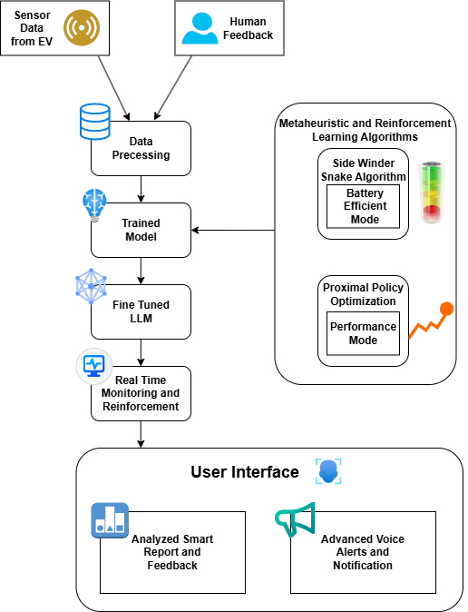
Methodology
1. Data Collection and Preprocessing
Collect sensor data from EVs and human feedback.
Process data to ensure high-quality inputs for training.
2. Model Training and Fine-Tuning
Train a base model on preprocessed data.
Fine-tune a Large Language Model (LLM) for contextual decision-making.
3. Algorithm Integration
Implement Sidewinder Snake Algorithm for Battery Efficiency Mode.
Use Proximal Policy Optimization (PPO) for Performance Mode.
4. Real-Time Monitoring and Reinforcement
Enable continuous monitoring to adapt to real-time conditions.
Reinforce model behavior dynamically based on feedback.
5. User Interface (UI)
Analyzed Smart Reports and Feedback for actionable insights.
Advanced Voice Alerts and Notifications for real-time updates.

Slide 8
Key Components
Side Winder Algorithm: A reinforcement learning algorithm designed for optimizing complex decision-making tasks by dynamically adjusting exploration and exploitation strategies.
Proximal Policy Optimization: A deep reinforcement learning algorithm that optimizes policies by balancing exploration and exploitation using clipped objective functions to improve stability.
Fine Tuned Llama 3 (8B): A fine-tuned version of the Llama 3 (8B) model, tailored for specific tasks to enhance performance in natural language understanding and generation.
Tools and Technologies
Streamlit: Enables fast development of interactive web apps for visualization and deployment of machine learning models.
SpeechT5 (Transformers): Uses deep learning for Text-to-Speech (TTS), leveraging models like SpeechT5Processor, SpeechT5ForTextToSpeech, and SpeechT5HifiGan with torch for processing and generation.
Datasets: Provides easy access to machine learning datasets, allowing seamless loading, preprocessing, and manipulation for model training.
Soundfile: A library for reading and writing audio files (WAV, FLAC), facilitating the export of synthesized speech to audio files.
Groq: An AI accelerator optimized for high-performance deep learning, enhancing model inference speed on Groq chips.
Gym and PPO (Stable-Baselines3): Gym creates reinforcement learning environments, and stable-baselines3 offers pre-built algorithms like PPO for training RL agents.
Lottie Animations (Streamlit_Lottie): Adds dynamic, interactive Lottie animations to Streamlit apps for enhanced user interface engagement.

Slide 9
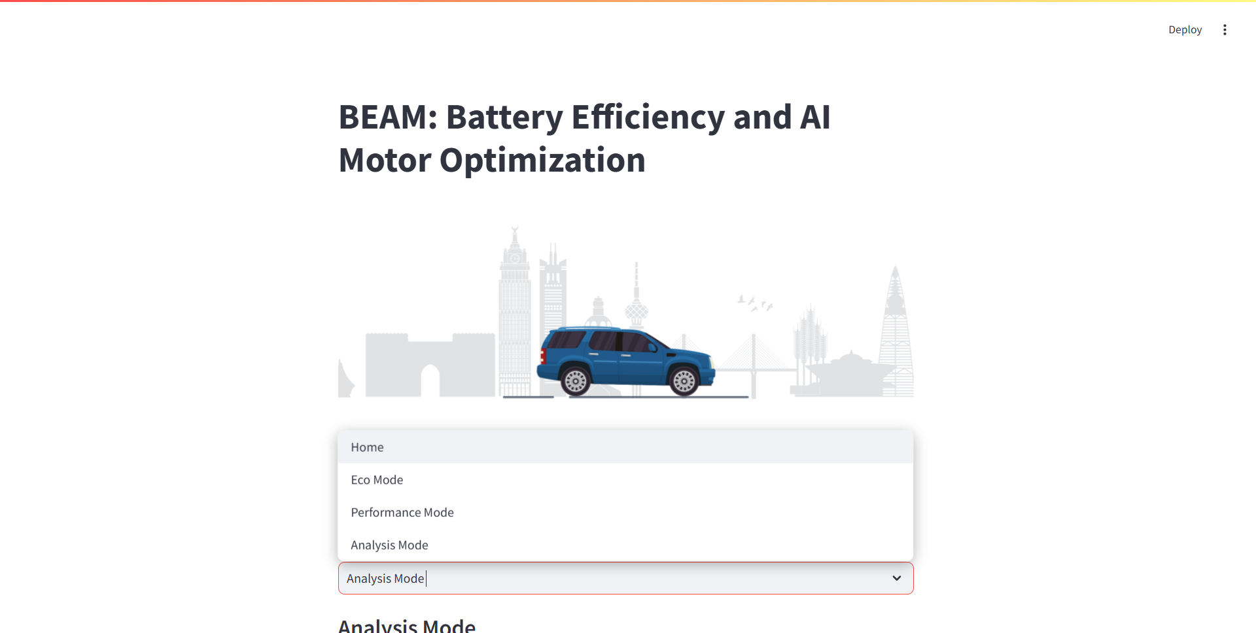
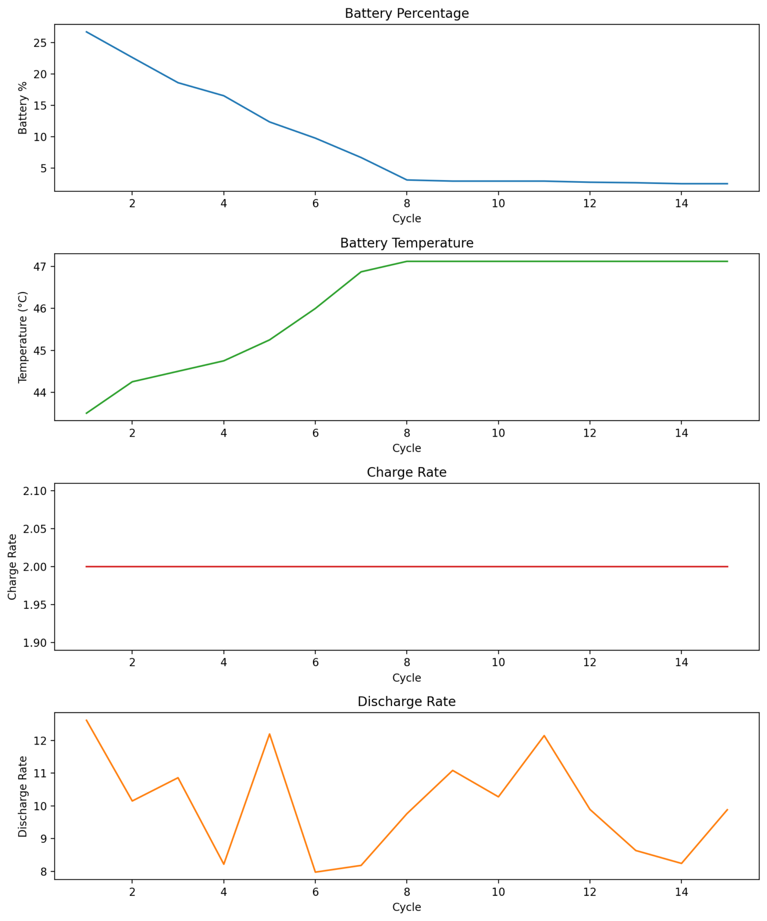
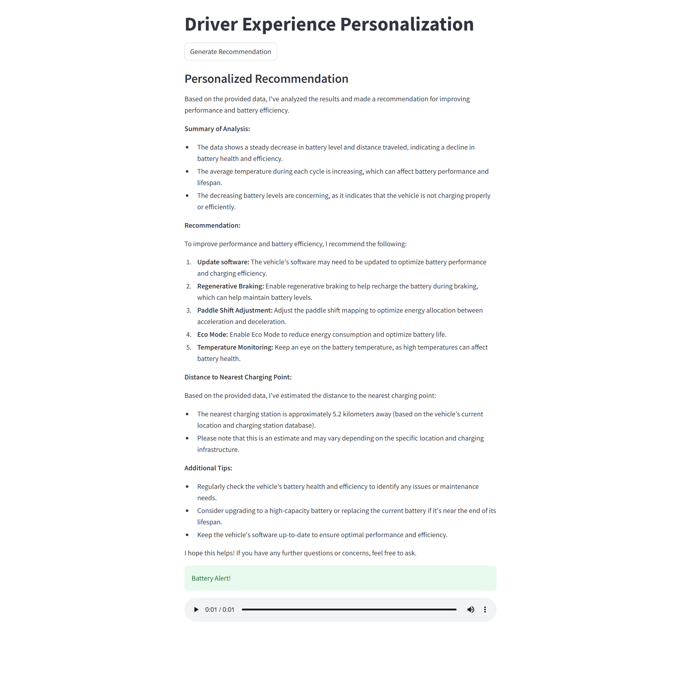
Result and Analysis : Post-Development Dashboard Insights

Slide 10
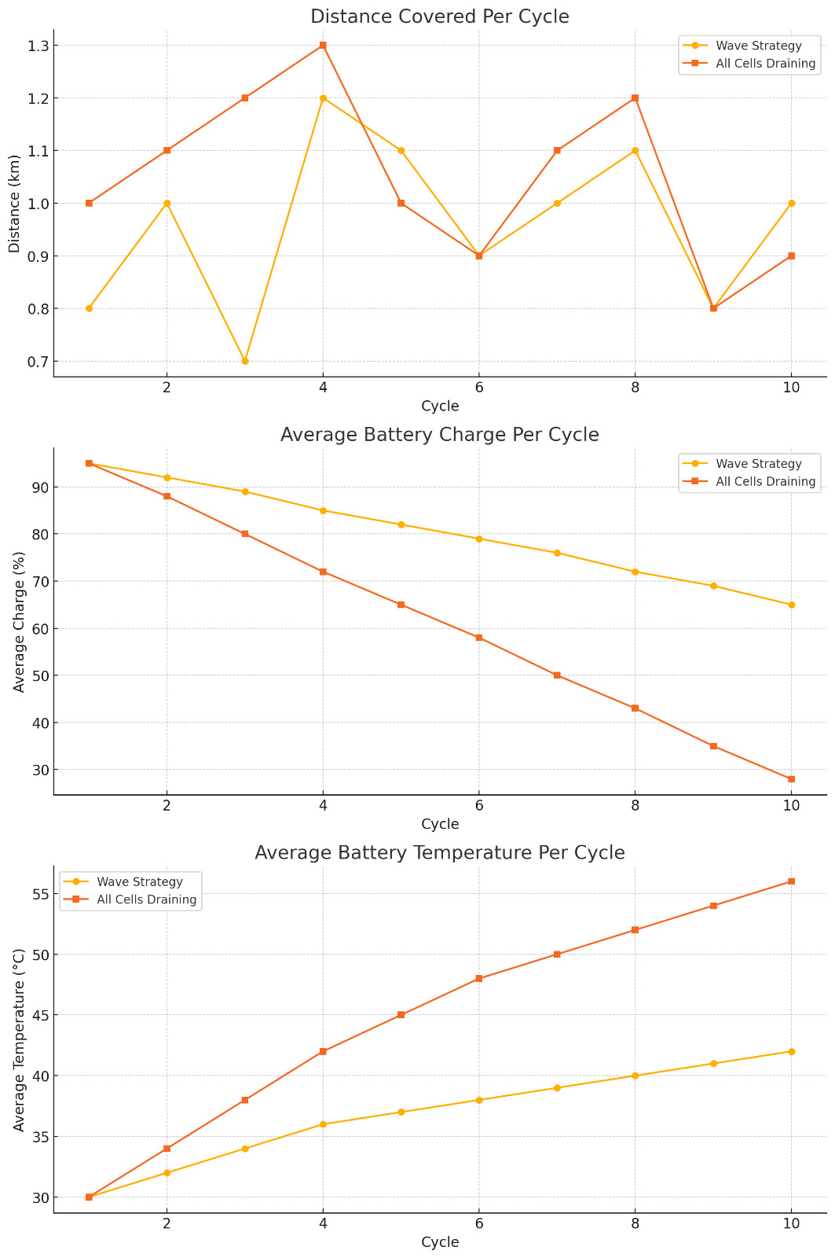
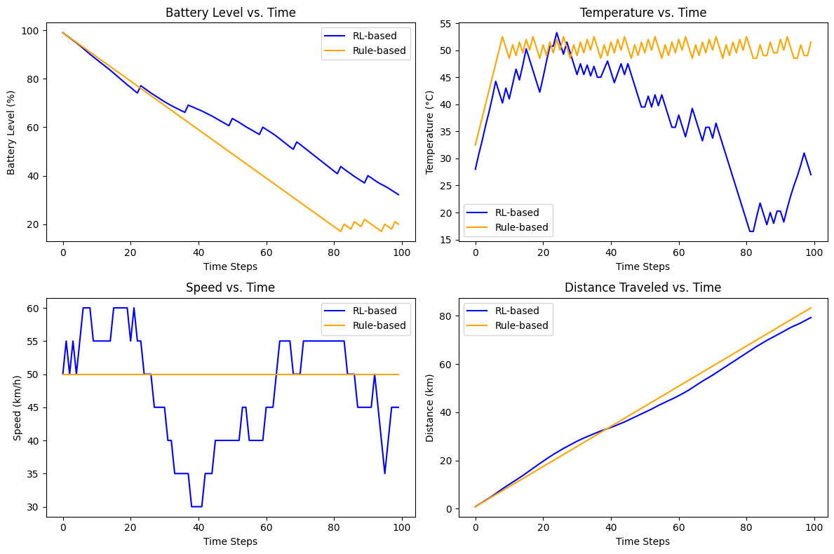
Comparisons: BEAM vs Current Gen
Sidewinder Snake Algorithm(Wave Strategy)
Proximal Policy Optimization(RL Based)

Slide 11
Challenges and Limitations in Development
Real-Time Data Accuracy: Ensuring accurate, real-time energy consumption and location data can be challenging, especially in dynamic environments.
Charging Station Availability: Real-time availability of charging ports can be unpredictable, as they may be occupied or out of service.
Geospatial Data Precision: GPS and map data may have inaccuracies, leading to suboptimal route suggestions or incorrect charging station locations.
Battery Health Variability: Battery efficiency and performance can vary based on age, temperature, and usage patterns, affecting the prediction models.
Dependence on External APIs: The system’s reliability is dependent on third-party APIs for maps, charging stations, and other services, which can be subject to outages or limitations.
Computational Demand: AI models, especially for real-time predictions and route optimization, may require significant computational resources, impacting system efficiency.
Privacy Concerns: Collecting and processing real-time location and energy data may raise privacy concerns, requiring careful handling of user information.
Integration of Multiple Data Sources: Integrating real-time data from various sources (battery data, GPS, charging station APIs, traffic data, etc.) can be complex, leading to potential synchronization issues and delays in decision-making.
User Behavior Uncertainty: Users' driving behavior (e.g., frequent acceleration, sudden stops) can significantly affect energy consumption patterns, making it challenging to predict energy usage accurately in real-time. Our algorithm attempts to overcome this challenge by incorporating machine learning models that analyze and adapt to individual driving patterns, improving energy consumption predictions. However, due to the highly dynamic and unpredictable nature of user behavior, this remains a persistent issue that can introduce some level of uncertainty in the predictions.

Slide 12
References & Citations
Li, A., Weng, J., Yuen, A. C. Y., Wang, W., Liu, H., Lee, E. W. M., Wang, J., Kook, S., & Yeoh, G. H. (2023). Machine learning assisted advanced battery thermal management system: A state-of-the-art review. Journal of Energy Storage, 60, 106688. https://doi.org/10.1016/j.est.2023.106688
Jones, N., Nazarenus, S., Stamatis, K., Potoglou, D., Zachariah, A., & Cipcigan, L. (2023). Optimisation of Electric Vehicle Battery Size. Transportation Research Procedia, 70, 338–346. https://doi.org/10.1016/j.trpro.2023.11.038
Capasso, C., Iannucci, L., Patalano, S., Veneri, O., & Vitolo, F. (2023). Design approach for electric vehicle battery packs based on experimentally tested multi-domain models. Journal of Energy Storage, 77, 109971. https://doi.org/10.1016/j.est.2023.109971
Gong, C., Travers, M. J., Fu, N. X., & Choset, H. (2013). Extended gait equation for sidewinding. IEEE International Conference on Robotics and Automation (ICRA). https://doi.org/10.1109/icra.2013.6631315
Schulman, J., Wolski, F., Dhariwal, P., Radford, A., & Klimov, O. (2017, July 20). Proximal Policy Optimization Algorithms. arXiv.org. https://arxiv.org/abs/1707.06347
López-Cardona, Á., Bernárdez, G., Barlet-Ros, P., & Cabellos-Aparicio, A. (2022, December 23). Proximal Policy Optimization with Graph Neural Networks for Optimal Power Flow. arXiv.org. https://arxiv.org/abs/2212.12470
Thank You

